Slide 1
SPEAKING SESSION 4
Company & values

Slide 2
REVIEW 1 - PRONUNCIATION
Please read out loud the following words:
personality
psychologist
researcher
circumstance
uncertainty
career
expertise
touch
hand sanitizer
social distancing

Slide 3
REVIEW 2 - VOCABULARY
Please make your own sentences with the following words:
cultivate (v)
stability (n)

Slide 4

source

Slide 5
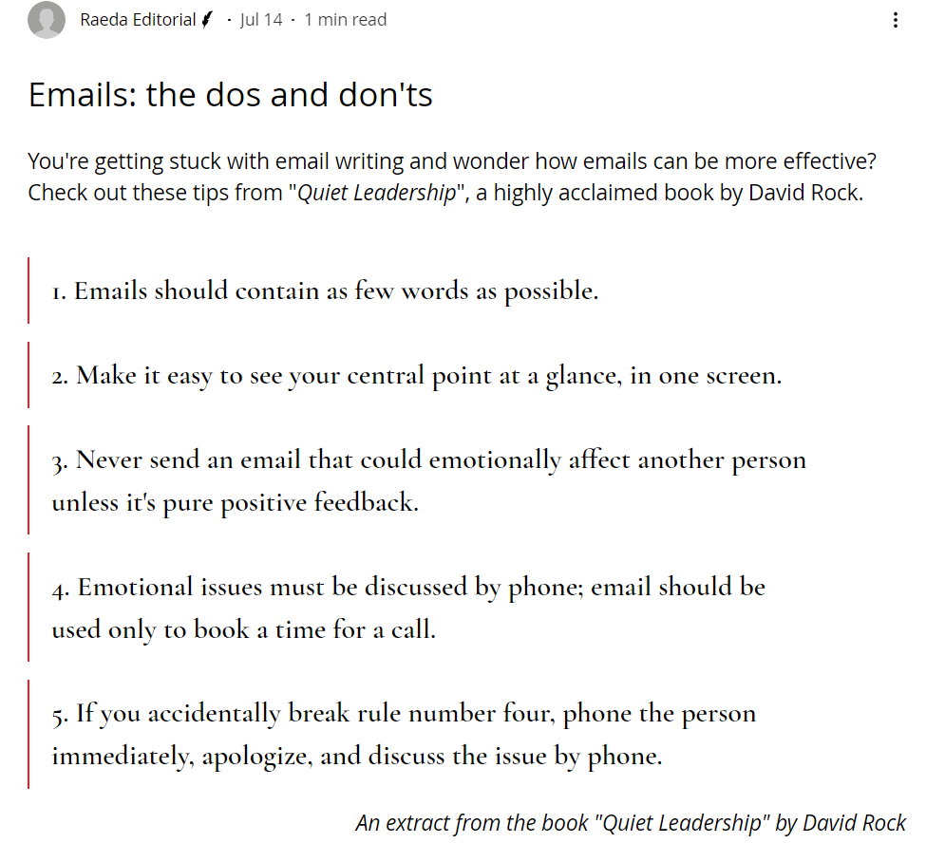
PRONUNCIATION EXERCISE

Slide 6

REFLECT ON A PHOTO

Slide 7
Constrained resources /understaffed
Lack of OT ~ insufficient OT for staff
The staff are not paid enough OT for the work.
The OT payment are insufficient for the staff.
Sufficient (a) >< insufficient
Retrospective (a) >< retroactive (a)
Backdated

Slide 8
ANSWERING SHORT QUESTIONS
What are your company’s values?
Which value(s) do you love the most?
→ transparency
→ Equality

Slide 9
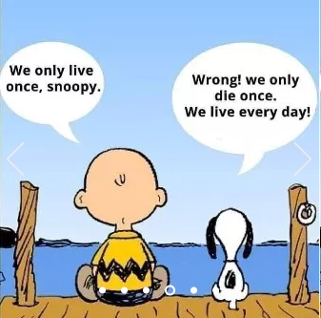
TOPIC FOR DISCUSSION

